Slide 1

B.Tech. Computer Science and Engineering
BCSE497J - Project-I
A RELIABILITY-GUIDED VIT–MAMBA FRAMEWORK WITH FACIAL LANDMARK FUSION FOR STUDENT ENGAGEMENT RECOGNITION
Team members:
ILAKKIYA S 23BCE2012
ADHVAITH N A 23BCE2064
DON GEORGE 23BDS0006
Faculty guide:
DEEPIKA J

Slide 2
Approval Mail From Guide

Slide 3
Aim
To recognise student engagement from webcam video by measuring how reliable each observation is, and weighting frames accordingly - without ever discarding them - so that the temporal model receives an intact, uniformly spaced sequence.
Reliability is treated as an observation-quality signal, never as an engagement cue: a turned head means the evidence is weaker, not that the learner is disengaged.

Slide 4
Abstract
Problem: engagement recognition fails less because the classifier is weak than because the observations are unreliable - occlusion, blur, and faces leaving frame.
Conventional fix: discard low-quality frames. This changes the sequence length and destroys the uniform temporal spacing a sequence model depends on.
This work: a per-frame Motion Reliability Score (MRS) from five observation-quality signals, applied as a soft weight in place of a hard gate, so every frame keeps its position in the sequence.
Architecture: frozen ViT-B/16 per frame -> MRS weighting -> Mamba selective state-space temporal encoder -> fusion with a MediaPipe geometric/blendshape branch -> 4-class MLP.
Novelty: This work uses reliability as a soft weight instead of removing bad frames, keeping the sequence complete and in order. The model learns how important each reliability factor is from the data itself, without using engagement labels. It also shows that normalisation after weighting can cancel its effect, so where reliability is added to the network is important.
Result: 38.75% validation accuracy vs a 25% chance baseline on a balanced, subject-disjoint partition (binomial p = 0.0046). Under controlled degradation MRS falls from 0.657 to 0.484, confirming it measures observation quality.

Slide 5
Literature Review
Paper | Objective | Methodology | Pros / Cons | Findings
DAiSEE: Towards User Engagement Recognition in the Wild Gupta et al., 2016 [1] | Benchmark engagement in the wild | 9,068 webcam clips, 112 subjects; 4 affective states at 4 intensity levels | + realistic uncontrolled capture - severely imbalanced | Accuracy alone is inadequate; macro-F1 and a balanced subset are needed
LRCN; C3D; TimeSformer Donahue et al., 2015 [3]; Tran et al., 2015 [4]; Bertasius et al., 2021 [5] | Treat engagement as a sequence, not a still image | CNN features fed to an LSTM; 3D convolution; frame-wise self-attention | + captures long-range context - attention is quadratic in clip length | Temporal context helps, but cost grows quickly with the frame count
Mamba; Vision Mamba (Vim) Gu & Dao, 2023 [6]; Zhu et al., 2024 [7] | Linear-time sequence modelling | Selective state-space model with input-dependent parameters; Vim scans image patches | + linear time, selective memory - applied spatially, not across frames | Motivates scanning across frame embeddings, which is what this work does
MediaPipe; Face Mesh; BlazeFace Lugaresi et al., 2019 [9]; Kartynnik et al., 2019 [10]; Bazarevsky et al., 2019 [11] | Recover face geometry without a separate AU model | BlazeFace detection; 478 landmarks with iris refinement; 52 ARKit blendshapes | + real-time, AU-like semantics for free - degrades under occlusion | Supplies the geometric branch and four of the five MRS inputs
Variance of the Laplacian; SER-FIQ Pech-Pacheco et al., 2000 [12]; Terhörst et al., 2020 [13] | Estimate how usable an observation is | Variance-of-Laplacian sharpness; SER-FIQ embedding-robustness quality | + label-free - used to filter frames out, not to weight them | The gap addressed here: quality as a soft per-frame weight inside the model

Slide 6
Research Gap
1. Reliability is used as a gate, not a weight. Existing quality-aware pipelines threshold frame quality and delete frames below it. For a temporal model this is self-defeating: the sequence length changes, the gaps close, and a degraded clip is no longer comparable to a clean one.
2. Reliability weights are asserted, not learned. Where multi-factor quality scores exist, the relative importance of the factors is fixed by hand - usually uniform. Whether blur, occlusion, head rotation and motion deserve equal influence is an empirical question that is rarely asked.
3. Reliability and behaviour are conflated. Head rotation and eye closure are often read as disengagement. A turned head means the frontal evidence is weaker; a blink is normal behaviour. A score contaminated by the label is no longer a reliability score.

Slide 7


Objectives
O1 Verified DAiSEE pipeline - official split, subject disjointness measured and confirmed zero.
O2 Five-component MRS in [0,1], computed only from observation quality.
O3 Integrate MRS into ViT + Mamba so temporal positions are provably preserved.
O4 Learn the five MRS weights from a 0.20 initialisation instead of fixing them.
O5 Fuse a MediaPipe geometric/behavioural branch; fit all statistics on train only.
O6 Evaluate against explicit chance and majority baselines with significance testing.
O7 SHAP attribution grouped into interpretable facial feature families.
Identified: 4 | TRL - 3

Slide 8
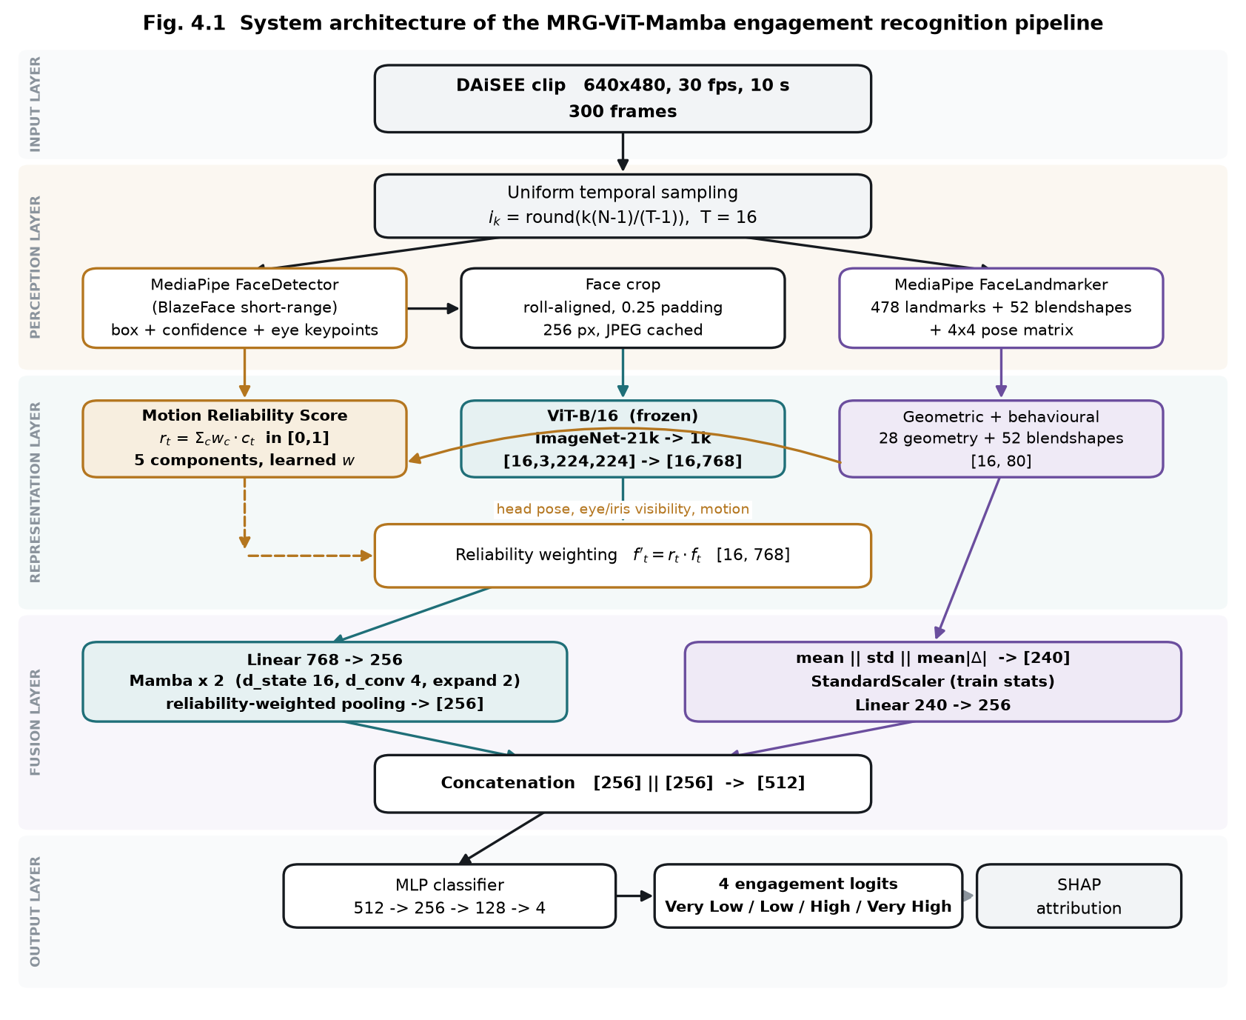
Framework/Architecture/Block Diagram
Frozen ViT-B/16 per frame | MRS weighting | 2 x Mamba temporal encoder | MediaPipe branch | fusion -> 4-class MLP

Slide 9
Functional Requirements
FR-1 to FR-5 Dataset audit: parse labels, join every clip, decode-probe each video, derive subject IDs, and refuse to proceed on any split overlap.
FR-6 to FR-8 Sampling: T uniformly spaced frames per clip (T configurable over 8/16/32/64), deterministic, always exactly T frames returned.
FR-9 to FR-12 Face processing: detect, roll-align on eye keypoints, pad and resize; on detection failure fall through a recorded chain - never drop the frame.
FR-13 to FR-17 Reliability: five components each in [0,1]; calibration fitted on the training split only; no engagement label may participate.
FR-18 to FR-21 Features: frozen ViT embedding (dimension discovered, not assumed); 478 landmarks + 52 blendshapes + head pose -> fixed-width vector.
FR-22 to FR-26 Model: apply MRS without altering temporal order; Mamba encoder; pool; fuse after separate normalisation; output 4 logits.
FR-27 to FR-32 Learning: MRS weights initialised at 0.20 and learned; checkpoint selected on validation macro-F1, never on test.

Slide 10
Modules
M1 Dataset index and audit - resolves clips, joins labels, verifies subject disjointness.
M2 Video sampling - uniform index rule, full sequential decode (seeking returns wrong frames).
M3 Face processing - MediaPipe BlazeFace detection, roll alignment, padded crop.
M4 Landmark extraction - 478 points, 52 blendshapes, 4x4 pose -> 28 geometric + 52 = 80/frame.
M5 Reliability scoring - five components; blur and face-size percentile-calibrated on train.
M6 ViT encoder - frozen backbone, batched [B,T,C,H,W] -> [B,T,768], cached to disk.
M7 Temporal encoder - vendored Mamba reference; MRS weighting + reliability-weighted pooling.
M8 Fusion and classifier - per-branch normalise, project to 256, concat 512 -> MLP -> 4.
M9 Evaluation and explainability - metrics, baselines, significance, SHAP attribution.

Slide 11
Experiments and Results
Setup - 216 DAiSEE clips, class-balanced (54 per class), subject-disjoint. 120 train / 80 validation / 16 test, from 48 / 17 / 11 distinct participants. All 216 decode; subject overlap between every pair of splits is zero.
Training - 64 epochs, AdamW, lr 3e-4 cosine, batch 8, class-weighted cross-entropy. MRS weights on a separate lr of 2e-2. Checkpoint chosen by validation macro-F1 (epoch 11).
Baseline - every split is balanced, so chance accuracy is exactly 25%.
Split | Clips | Accuracy | Weighted F1 | Macro F1 | Chance
Validation | 80 | 0.3875 | 0.3714 | 0.3714 | 0.2500
Test | 16 | 0.3750 | 0.3915 | 0.3915 | 0.2500
Validation: 31/80 correct, one-sided binomial p = 0.0046 (significant). Test (16 clips) p = 0.19 - directionally consistent but underpowered.

Slide 12
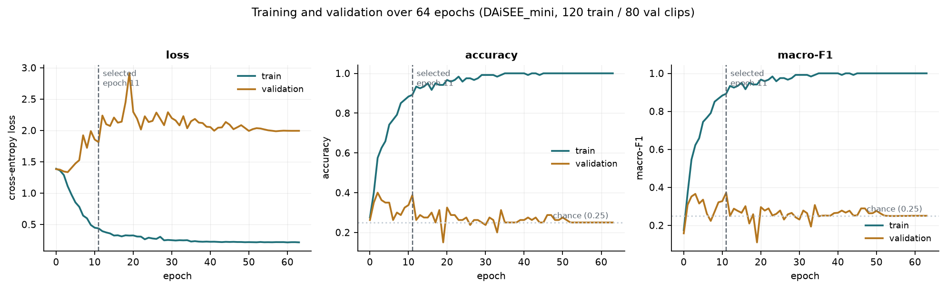
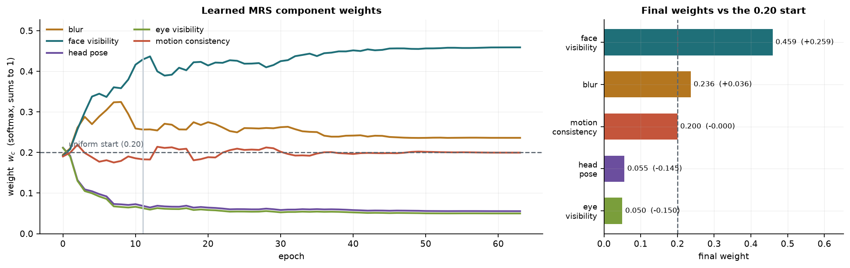
Experiments and Results - Training Behaviour
Training and validation across 64 epochs. Train accuracy saturates at 1.000; validation loss rises from about epoch 5 - overfitting on 120 training clips.
The five MRS weights start at 0.20 and converge to: face visibility 0.459, blur 0.236, motion 0.200, head pose 0.056, eye visibility 0.050.

Slide 13
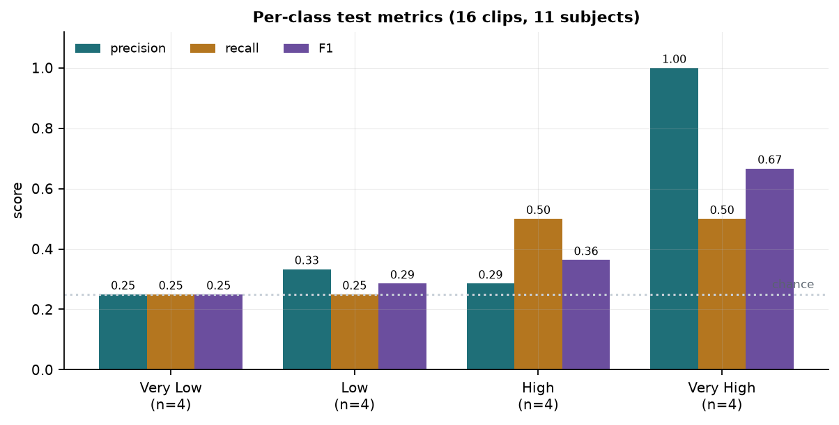
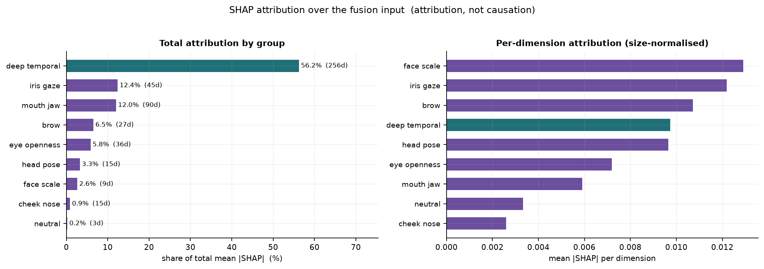
Experiments and Results - Per-Class Performance and SHAP
Per-class precision / recall / F1. All four classes are predicted.
SHAP attribution by feature group - iris/gaze is the strongest landmark contributor per dimension.
Low is the hardest class (F1 0.188): 12 of its 20 validation clips are absorbed into High - adjacent intensities are visually similar even for human annotators.
SHAP reports what the model relied on, not causation.

Slide 14
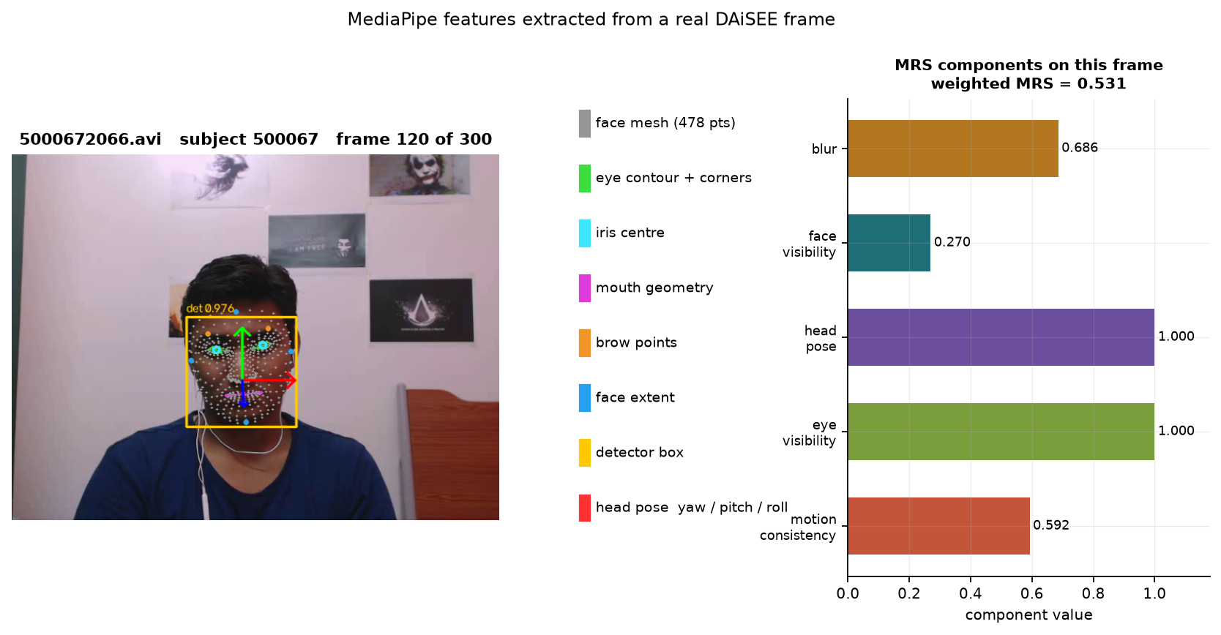
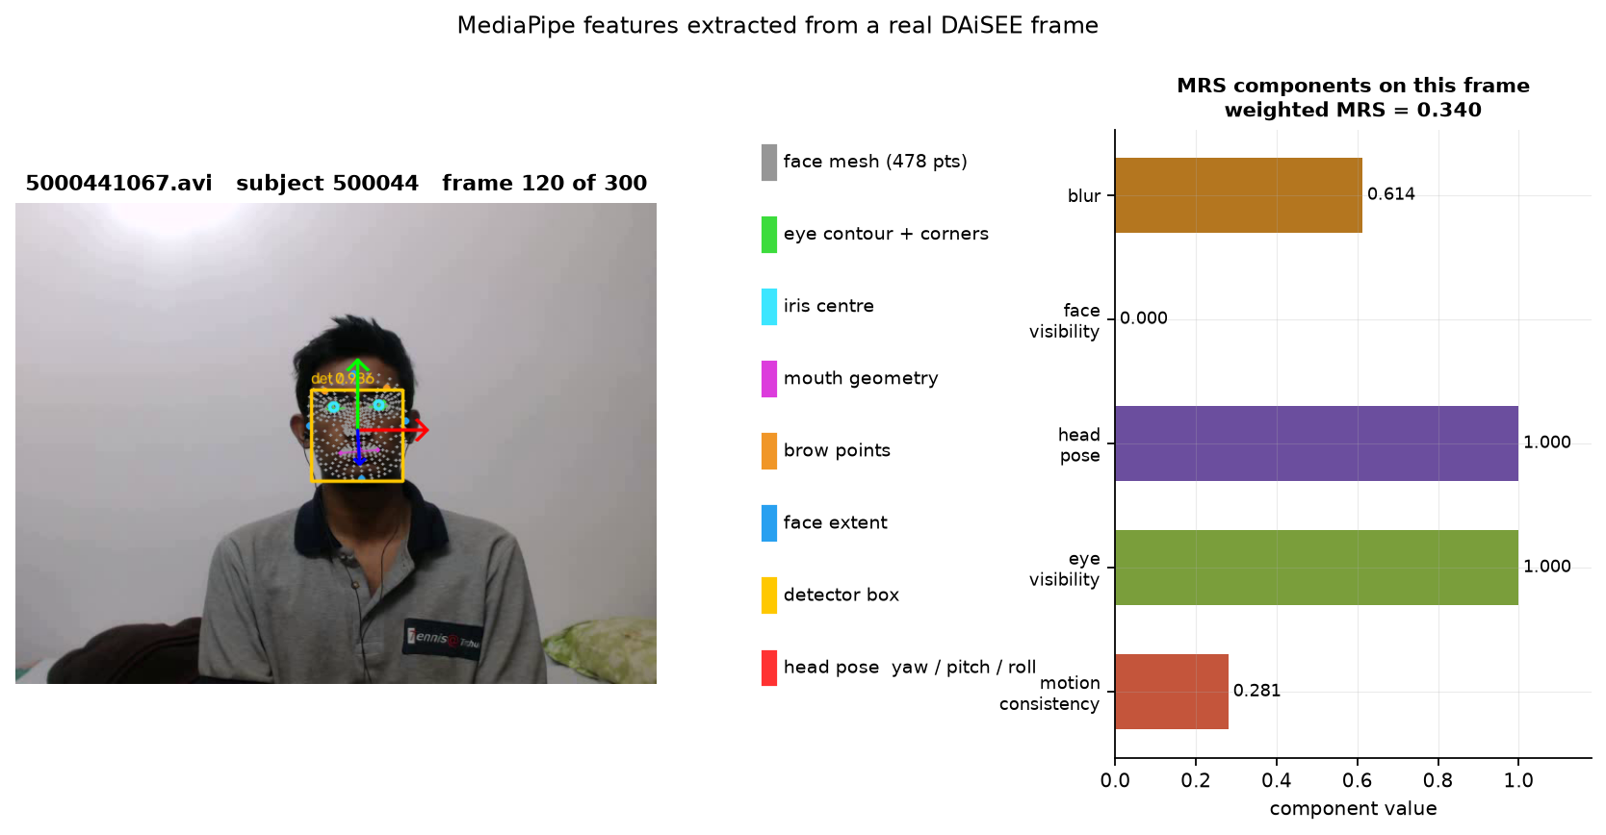
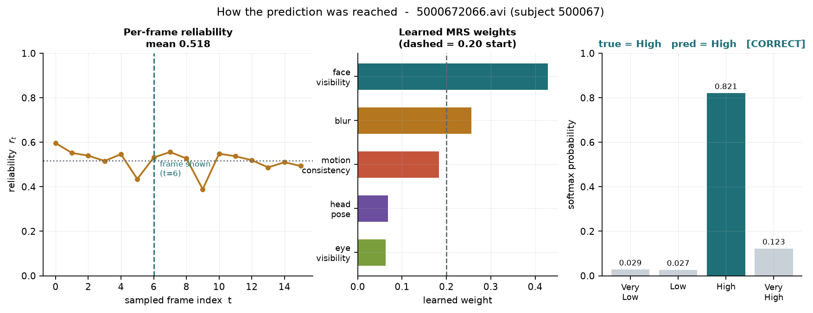
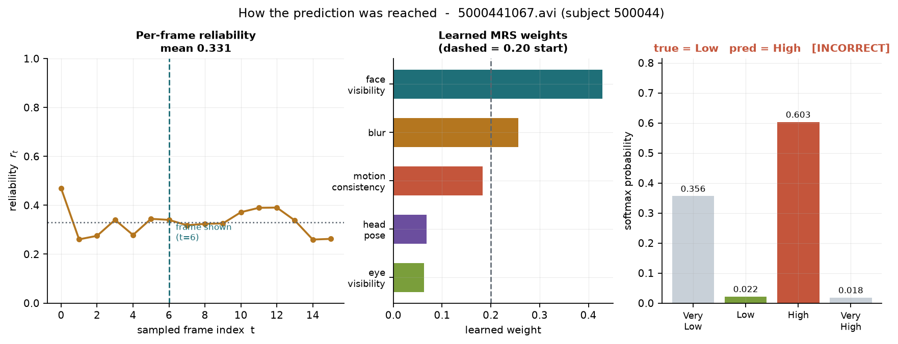
Experiments and Results - Worked Examples
Clip 5000672066 (subject 500067) - detector 0.976, clip MRS 0.518. True High, predicted High (p = 0.821). CORRECT
Clip 5000441067 (subject 500044) - clip MRS 0.331. True Low, predicted High (p = 0.603). INCORRECT
The misclassified clip has markedly lower reliability (0.331 vs 0.518): MRS independently flagged it as poorly observed, and the prediction on it was wrong.

Slide 15
Conclusion
Built and verified. A complete DAiSEE pipeline: audit, sampling, face and landmark extraction, reliability scoring, frozen ViT, Mamba temporal encoder, fusion, classification and SHAP. All 216 clips process without failure.
Reliability as a weight works. Frames are never dropped; the sequence length and spacing are identical for every clip regardless of degradation. Under controlled degradation the score falls as expected (0.657 clean -> 0.484 at 25% occlusion), so it measures what it claims to.
Learned weights agree with independent analysis. From a 0.20 start the optimiser concentrated on face visibility (0.459) and blur (0.236) and suppressed head pose (0.056) and eye visibility (0.050) - the same two components a separate variance analysis found to be near-constant. Head pose fell rather than rose, so no engagement cue leaked into the reliability term.
Above chance, with the caveat stated. 38.75% validation accuracy vs 25% chance, p = 0.0046. The 16-clip test split is not statistically powered.
Next: scale to the full 9,068-clip DAiSEE release, run multi-seed ablations, and fit the reliability weights against degradation severity so that no label influences MRS at all.

Slide 16
References
[1] A. Gupta, A. D’Cunha, K. Awasthi, and V. Balasubramanian, "DAiSEE: Towards user engagement recognition in the wild," arXiv:1609.01885, 2016.
[2] J. Whitehill, Z. Serpell, Y.-C. Lin, A. Foster, and J. R. Movellan, "The faces of engagement: Automatic recognition of student engagement from facial expressions," IEEE Trans. Affective Computing, vol. 5, no. 1, pp. 86–98, 2014.
[3] J. Donahue et al., "Long-term recurrent convolutional networks for visual recognition and description," in Proc. IEEE CVPR, 2015, pp. 2625–2634.
[4] D. Tran, L. Bourdev, R. Fergus, L. Torresani, and M. Paluri, "Learning spatiotemporal features with 3D convolutional networks," in Proc. IEEE ICCV, 2015, pp. 4489–4497.
[5] G. Bertasius, H. Wang, and L. Torresani, "Is space-time attention all you need for video understanding?," in Proc. ICML, 2021, pp. 813–824.
[6] A. Gu and T. Dao, "Mamba: Linear-time sequence modeling with selective state spaces," arXiv:2312.00752, 2023.
[7] L. Zhu, B. Liao, Q. Zhang, X. Wang, W. Liu, and X. Wang, "Vision Mamba: Efficient visual representation learning with bidirectional state space model," in Proc. ICML, 2024.
[8] A. Dosovitskiy et al., "An image is worth 16x16 words: Transformers for image recognition at scale," in Proc. ICLR, 2021.
[9] C. Lugaresi et al., "MediaPipe: A framework for building perception pipelines," arXiv:1906.08172, 2019.
[10] Y. Kartynnik, A. Ablavatski, I. Grishchenko, and M. Grundmann, "Real-time facial surface geometry from monocular video on mobile GPUs," in Proc. CVPR Workshops, 2019.
[11] V. Bazarevsky, Y. Kartynnik, A. Vakunov, K. Raveendran, and M. Grundmann, "BlazeFace: Sub-millisecond neural face detection on mobile GPUs," arXiv:1907.05047, 2019.
[12] J. L. Pech-Pacheco, G. Cristóbal, J. Chamorro-Martínez, and J. Fernández-Valdivia, "Diatom autofocusing in brightfield microscopy: A comparative study," in Proc. ICPR, 2000, pp. 314–317.
[13] P. Terhörst, J. N. Kolf, N. Damer, F. Kirchbuchner, and A. Kuijper, "SER-FIQ: Unsupervised estimation of face image quality based on stochastic embedding robustness," in Proc. IEEE CVPR, 2020, pp. 5651–5660.
[14] S. M. Lundberg and S.-I. Lee, "A unified approach to interpreting model predictions," in Proc. NeurIPS, 2017, pp. 4765–4774.
[15] I. Loshchilov and F. Hutter, "Decoupled weight decay regularization," in Proc. ICLR, 2019.

